Slide 1
University Student
Accommodation

Slide 2
What is available to you in your first year?
Halls of residence: these are the most common option for first year students and your university will be able to offer you a choice of university owned halls. Details of these will be on the website
Private student accommodation: these won’t be owned/controlled by your university but rather a private company. They tend to have better facilities but will be more money.
Private house: Some students choose to move straight into a private room in a house (often shared with other students).
Living at home. This is a choice some students take if they are already living in the city/area with family.

Slide 3
Pros and Cons: student accommodation
Halls of Residence Pros: Chance to meet new people/socialise Large choice to meet your needs Location Bills included (normally) Cons: Can have poor facilities Can have many distractions Less independence | Private Student Halls Pros: Good, up to date facilities Often a mix of students from different universities Purpose built for students Cons: More expensive than standard halls Not a registered university building (ie. your uni may not be able to help if something goes wrong (although they will be able to help/advise)
Private House Pros: More independence More likely to get involved in clubs and societies Chance to choose who you live with Cons: Will need to sort out your own bills etc Can be difficult to organise as not managed by the university (although they will be able to help/advise) Can work out to be more expensive | Living at Home Pros: No rent/bills to pay No need to leave family More likely to get involved in clubs and societies Cons: Less independence Can limit the amount of new people that you meet Can mean a lot of travel to university sites as unlikely to be easily located

Slide 4
Halls of Residence
Most popular option for first year students.
Allocated through university (first years given priority).
Each university will have multiple options of halls to live in.
Price is often all inclusive of heatings/water/wifi etc.
Each university has a different system but many will ask you to select your top three choices.
Often shared accomodation with other first year students.
Often located close to the university.
En-suite/shared bathroom.
Catered/non catered.
Often shared communal space.
It is crucial that you do your research before selecting the right one for you.

Slide 5
Halls of Residence example 1: Brighton
Brighton University offer 26 options for accomodation
https://www.brighton.ac.uk/accommodation-and-locations/university-accommodation/index.aspx

Slide 6
Halls of Residence example 2: Manchester
Manchester have campus options for halls of residence and 7-8 options in each campus (some for post-grad students only).

Slide 7
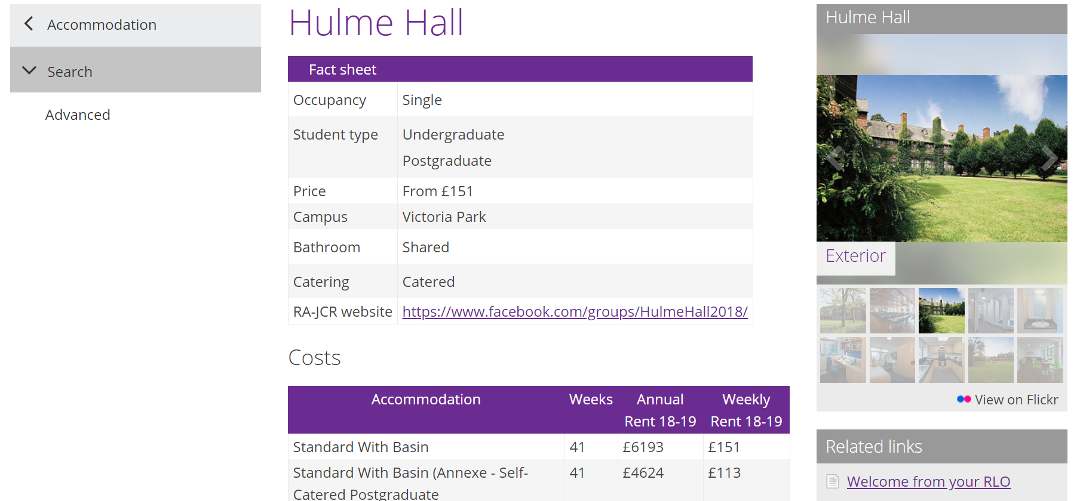
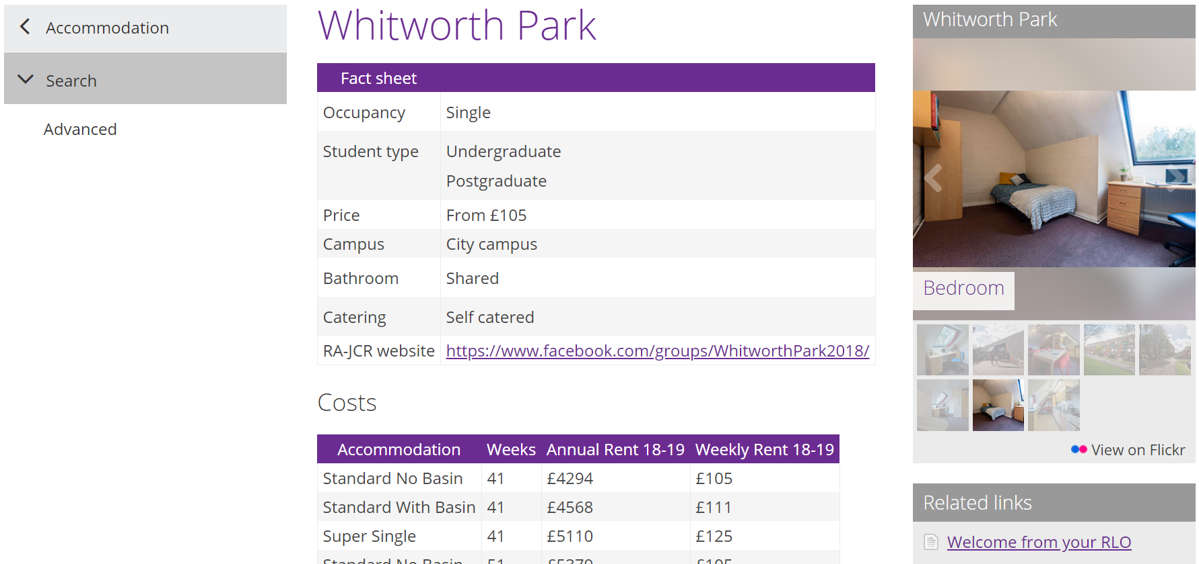
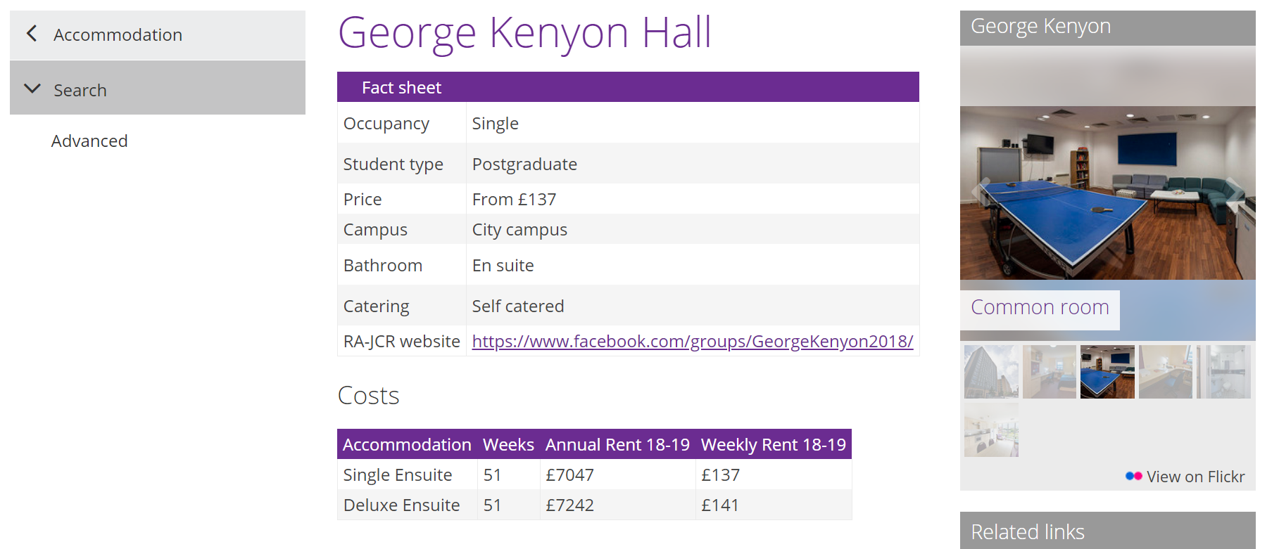

Slide 8
You can see how much variety there is just from the few examples shown. Spend some time looking at your choice of universities and what each offer you.
Think about:
Catered/non catered?
Shared bedroom?
Shared bathroom?
Location?
Cost per week?
Mix of students (ie. is it just for undergraduate or will post graduates be there too?
Extra facilities?
Insurance?

Slide 9
When to apply for halls of residence?
Each university will run a different system so it is essential that you check the website and your emails to see their deadlines.
In many cases you will be able to apply now if you have selected your firm choice of university.
You will often be asked for a first, second and third choice.
For your insurance choice, many universities will set up a waiting list system or similar (check their website for definite details) with priority being given to ‘firm choice’ students. If you get into your insurance rather than your firm following results day, don’t worry there will be plenty of other students in the same positions and a team of staff who will help you secure accomodation.
**If you are staying in London for uni, most universities will give priority to students who don’t have family in the city.

Slide 10
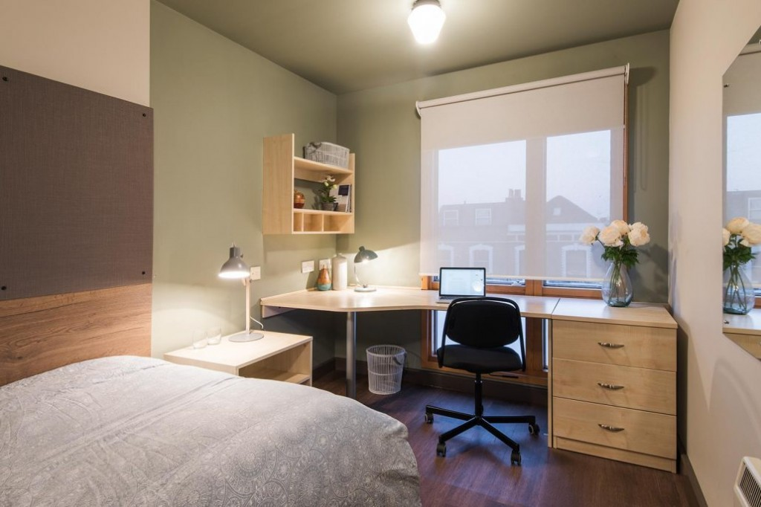
Private Student Halls of Residence
These are open to all students from all universities and are often located in larger cities with high student population. The facilities are often a high standard however they are often a more expensive option than university owned halls of residence.
Some companies that offer private student halls are:
https://www.mystudenthalls.com/
https://www.accommodationforstudents.com/student-halls
https://housing.london.ac.uk/find-accommodation/registered-independent-halls-residence

Slide 11
Private House
Many students will take this option in 2nd or 3rd year of university, once you have found some friends to house share with. However some do take this option in first year too, either renting a private room or finding a group to move in with. Bills often aren’t included and so you would have to also think about gas, electricity, internet, water etc.
https://www.accommodationforstudents.com
This website is a great starting point to search for options.

Slide 12
Key people who can help you at university with accommodation:
Student Services.
Every university will have a form of student services who are there to help you with any issue you may face from accommodation issues to mental health to careers. They are often broken down into subsections and can offer you expert advice.
Accommodation Office.
The accommodation office will be part of the student services and will be able to help with any issues you have with halls of residence (from securing a room to a broken oven) as well as offering advice on private rented accommodation.
Students’ Union.
Every university has a union which is a body of students (independent of the university) who act in the interest of the student body. Every SU will have a dedicated officer to represent you on a range of issues such as education, welfare, disability, diversity, the environment and more.
UCAS has provided a great variety of student insights in video forms:: https://www.ucas.com/connect/videos/uni-life/accommodation

